Slide 1
Final Presentation
Team 9
Mason Mechlin, Yamuna Rizal, Sitan Subedi, Dylan Pike, Zane Peckenpaugh
Notes:
sitan

Slide 2
Overview of all features implemented
User Interface
Shared Screen Play
Remote Play
Rewind
Player Creation
Notes:
sitan

Slide 3
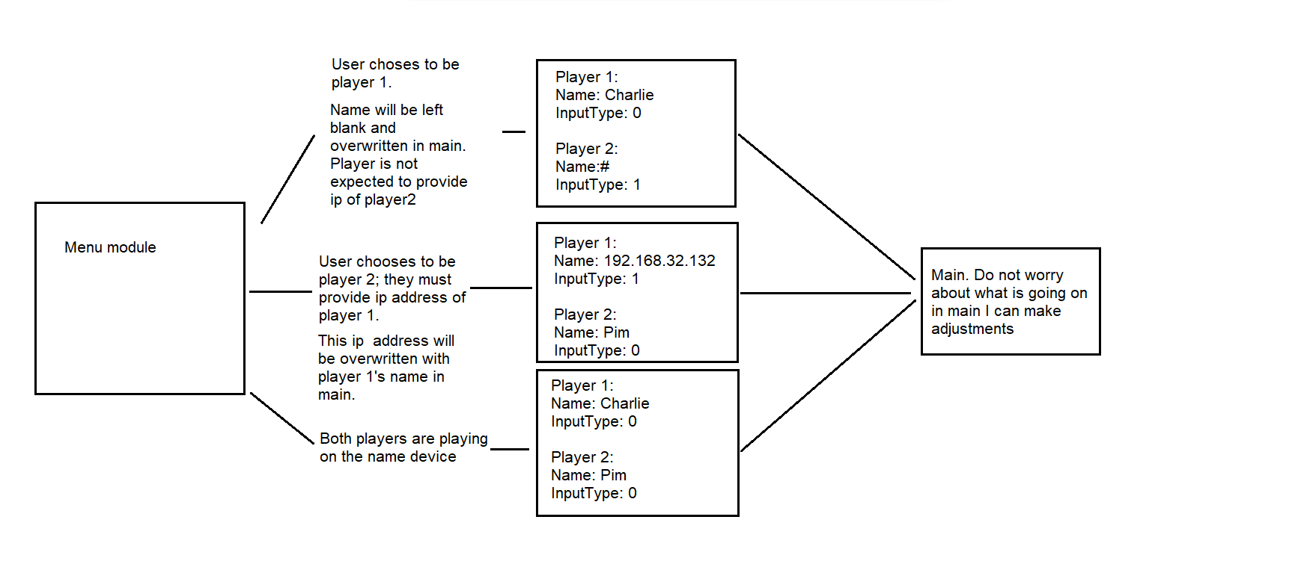
Remote Features

Slide 4
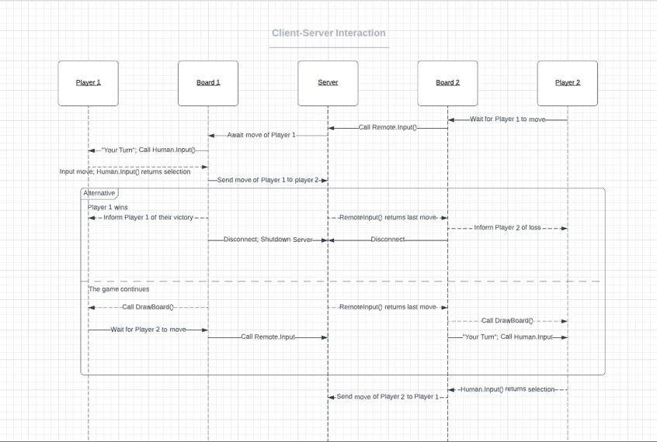
Advanced features

Slide 5
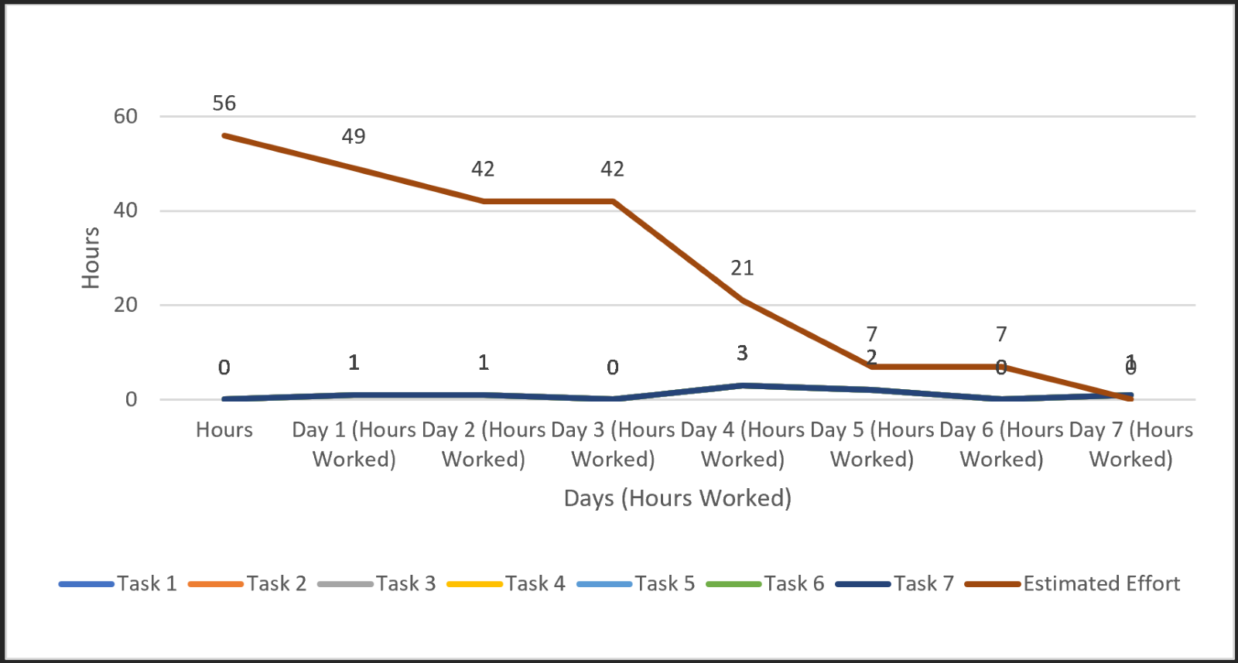
Project Management
Burndown chart
Planning and time management were most important aspect of the project.
Communication was important to maintain a healthy team environment.
Distributing work evenly among the teammates was crucial as well.

Slide 6
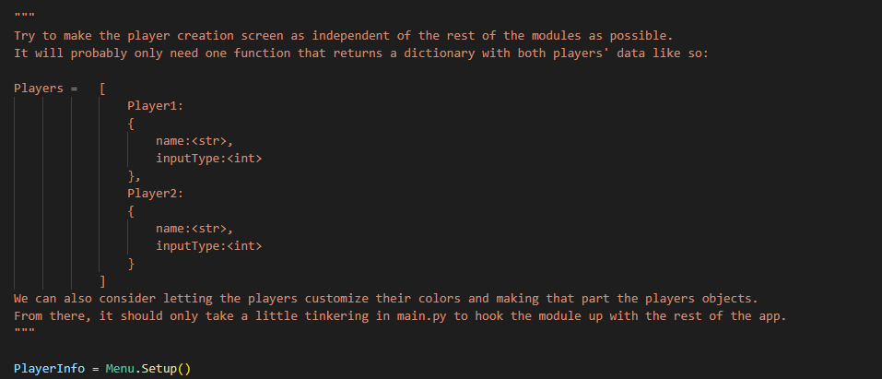
Project Management
Example
Prototyping phase.
Module Integration.
Defensive development.

Slide 7
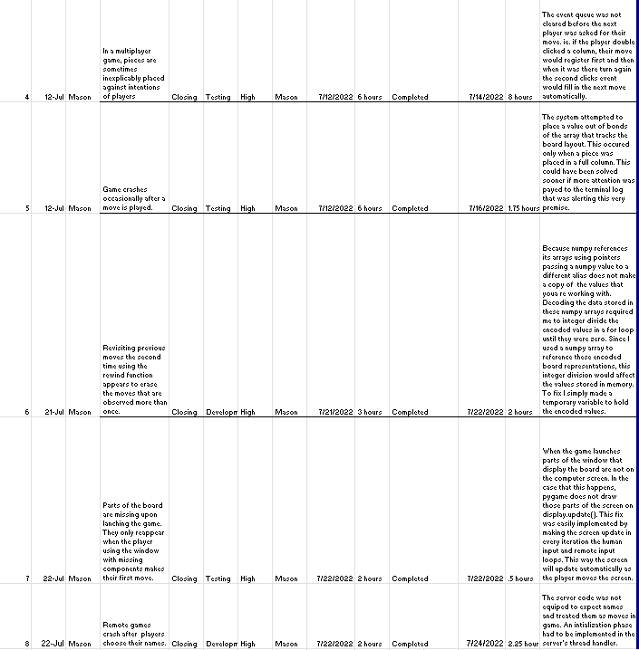
Defect Resolution
The system testing was done by the project manager. Unit testing for each module was assigned to developer who worked on them.

Slide 8
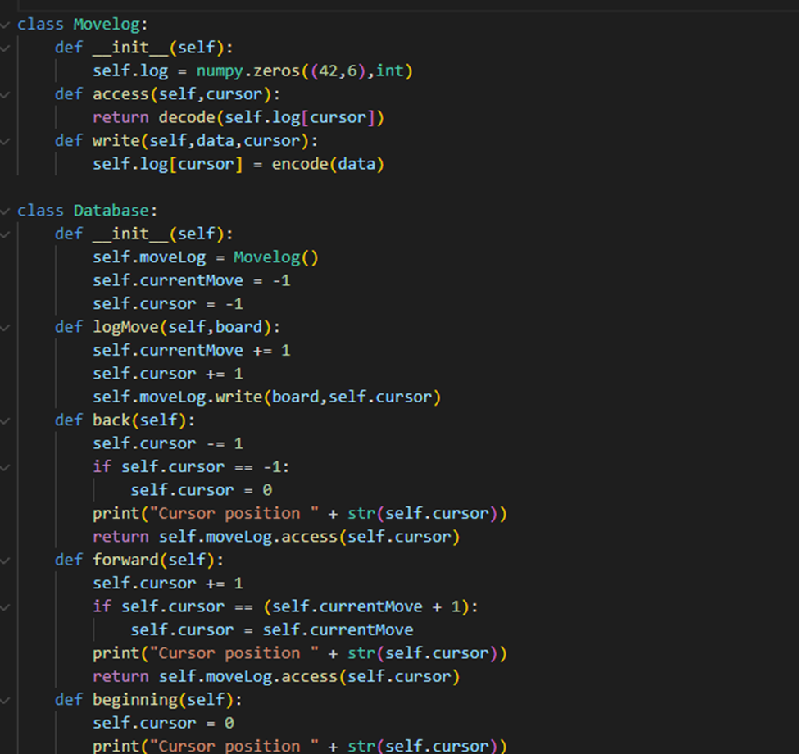
Known Issues and Future Plan
Rewind feature stores moves in memory.

Slide 9
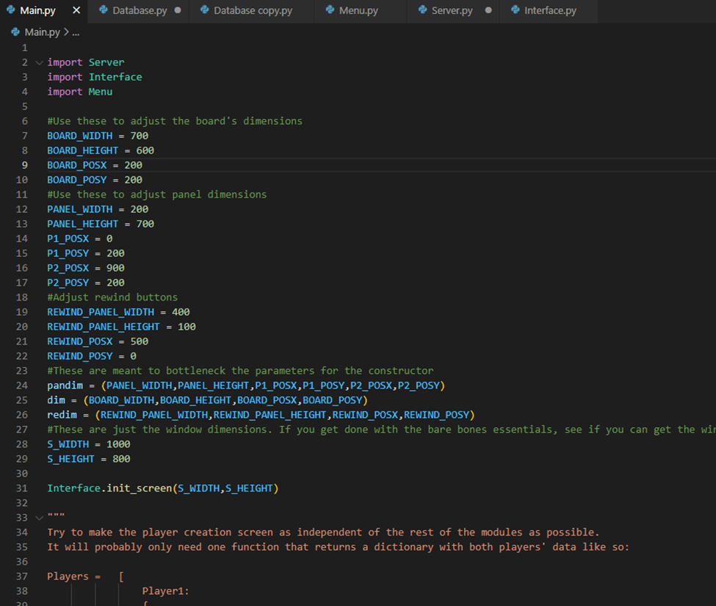
Known Issues and Future Plans
Remote play is limited to LAN.
Screen size/positioning configuration.
Accessibility
Robustness
Notes:
Sitan

Slide 10
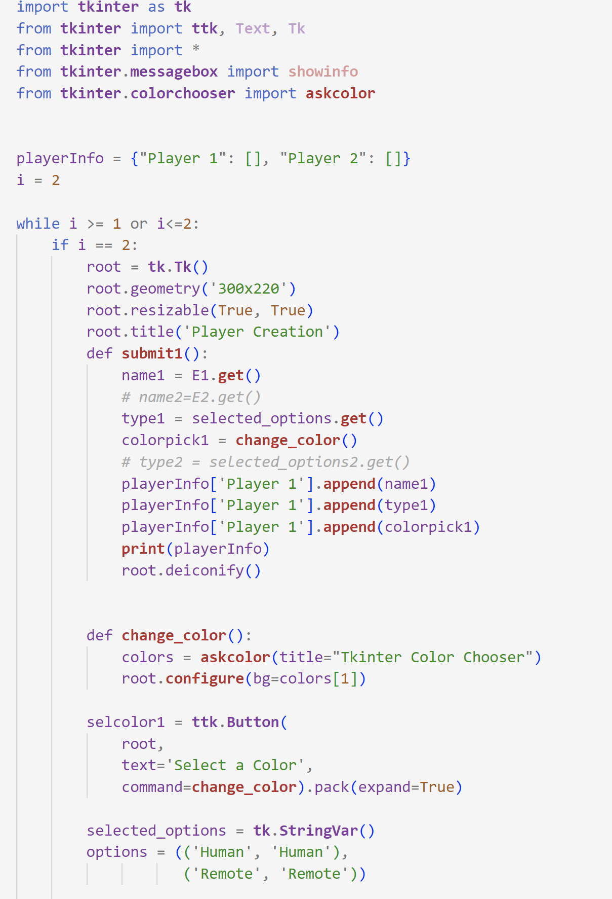
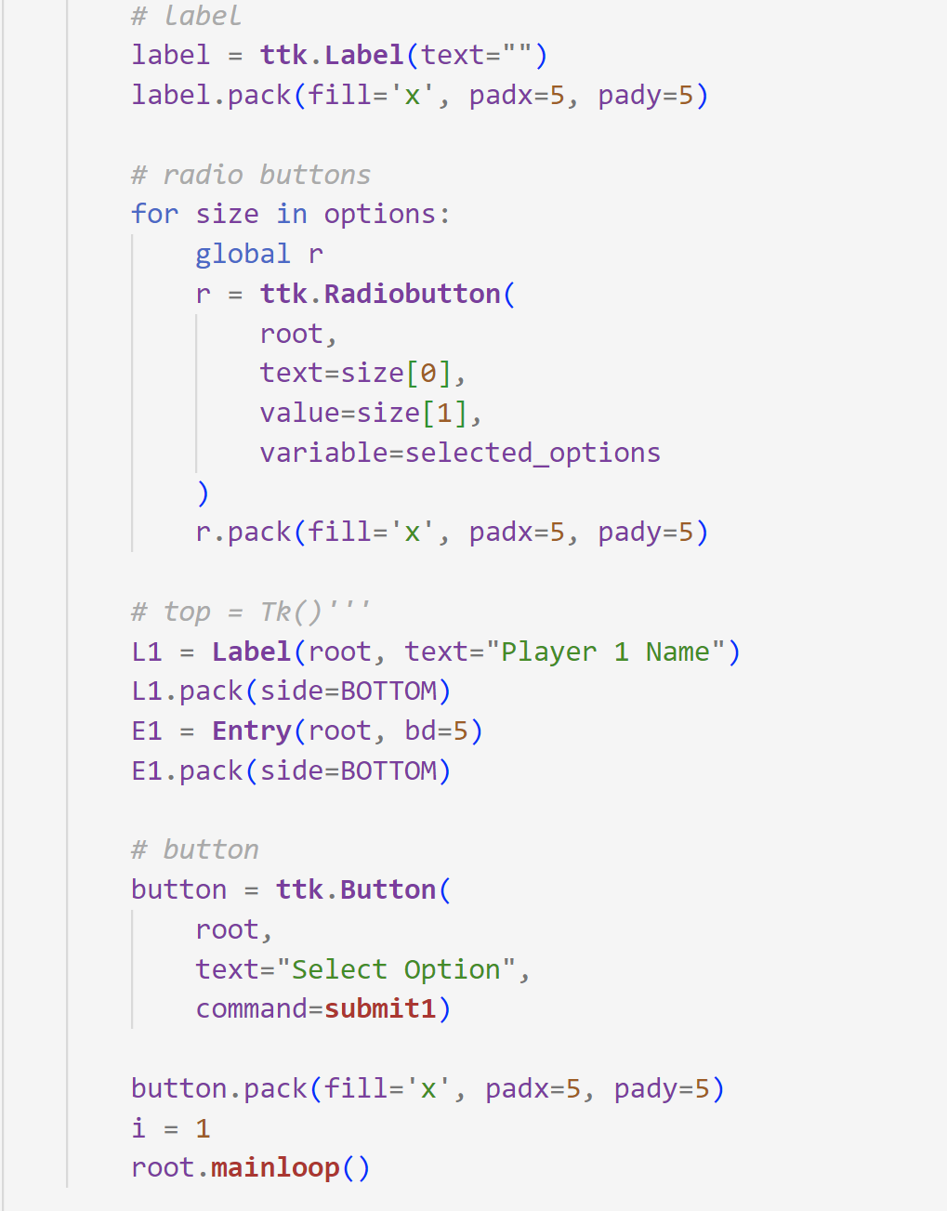
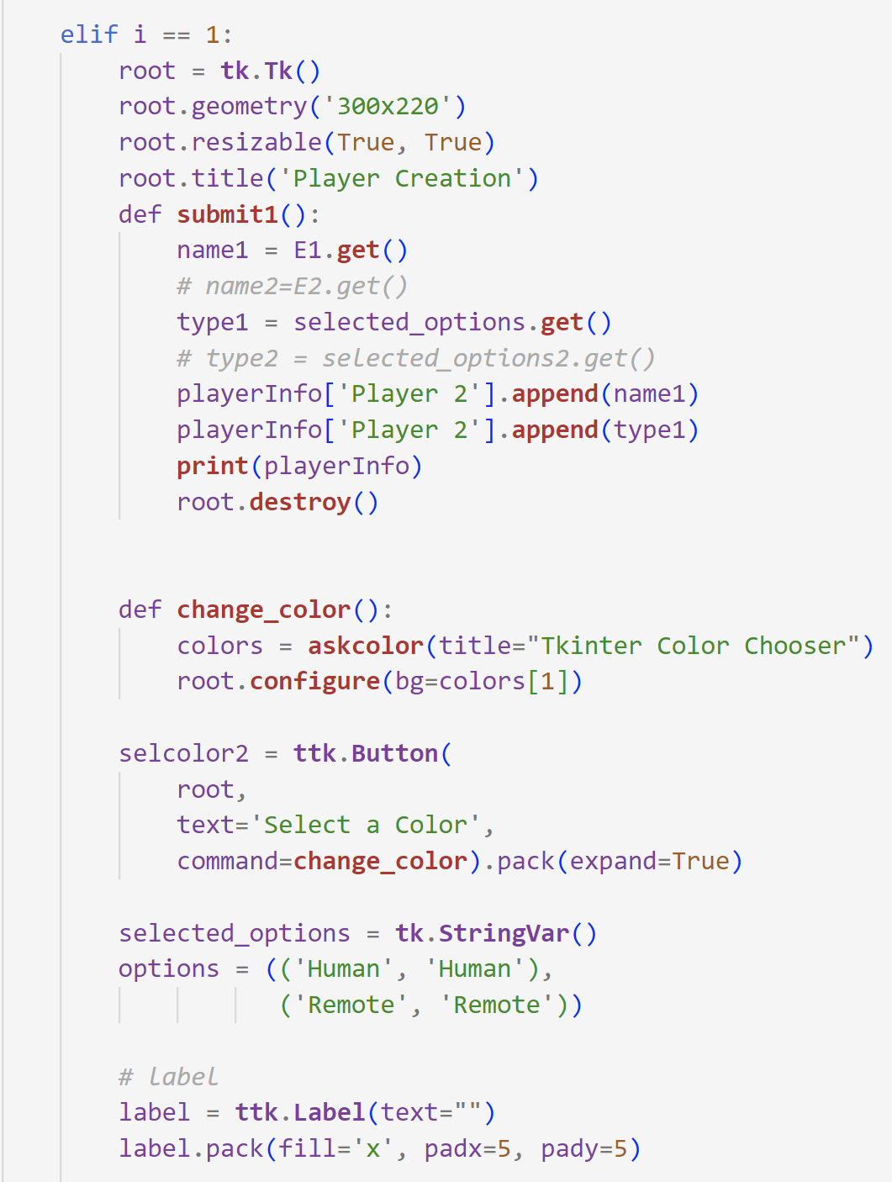
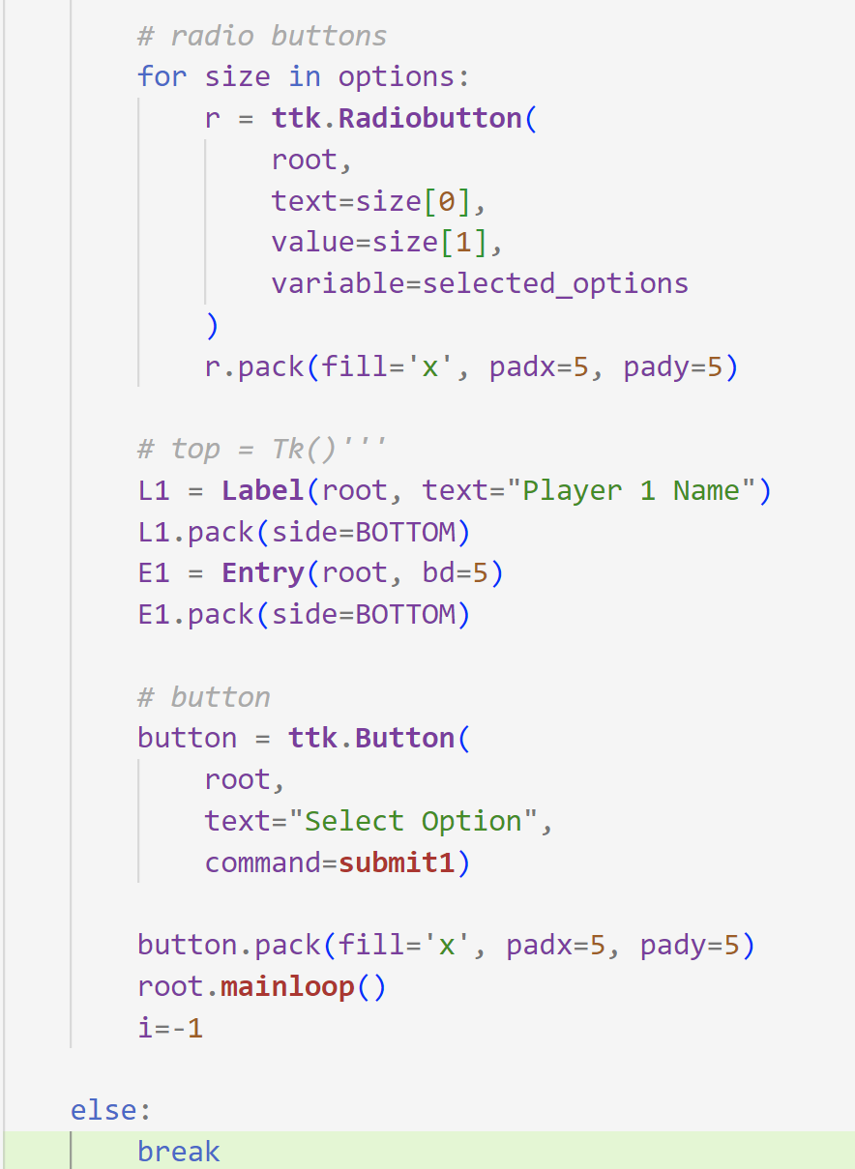
Player Creation

Slide 11
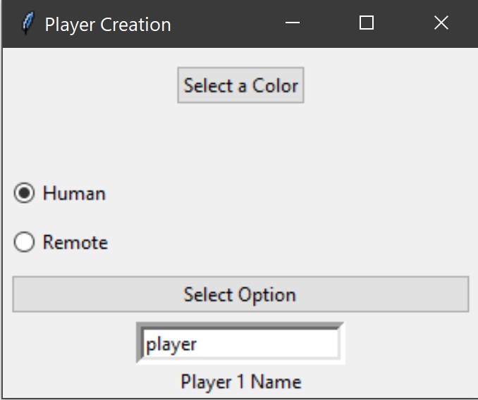
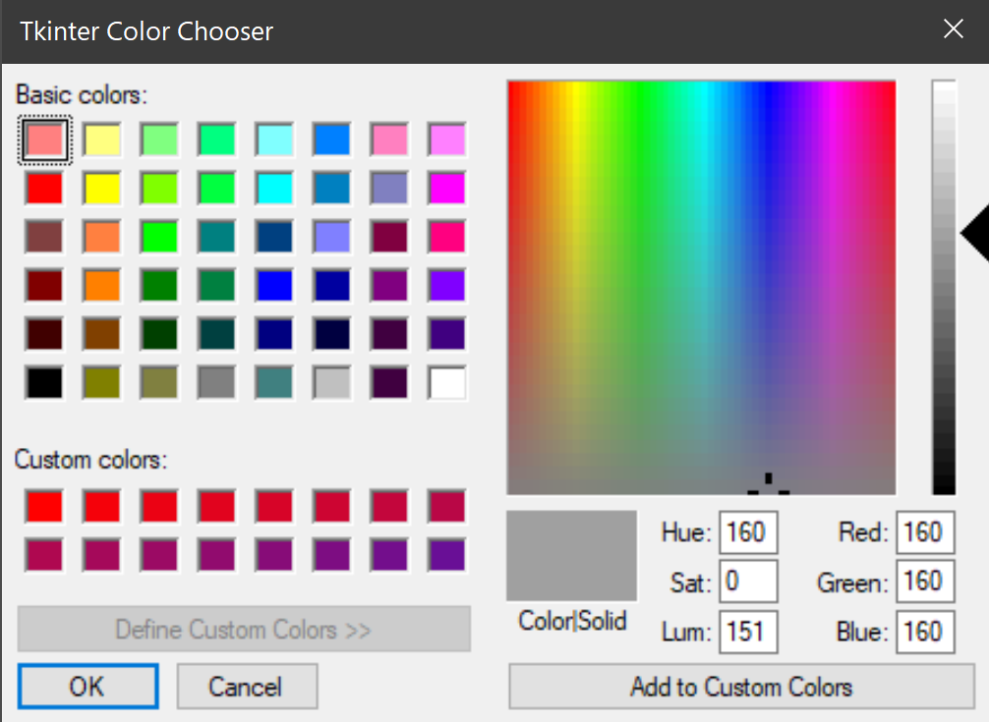

Slide 12
Demo of the project

